Slide 1
Practical Tips for Well-Being and Self-Care: How to Stay Happy in Law School and Law Practice?
Dr. Richard Wu
Associate Professor, Faculty of Law, HKU

Slide 2
WORLDWIDE DEPRESSION
Not only lawyers…
Notes:
4.3% of global population, over 300 million people suffer from depression
1 out of 10 people suffered from major depressive disorders at least once in their lifetime

Slide 3
In UK, 3,010 of every 10,000 legal professionals
has reported stress, depression or anxiety in the past three years
Law Society (England & Wales) report (2017)
“more than 90% of junior lawyers” are impacted by anxiety, stress and depression
“more than a quarter describing stress levels as ‘severe’ or ‘extreme’”
“more than half” said “they regularly/occasionally feel unable to cope at work due to pressure”
Law Society’s Junior Lawyer Division (2019)
“one in 15 junior lawyers (6.4%) experienced suicidal thoughts”
47% had experienced mental ill-health from work-related stress

Slide 4
US Well-Being Reports (2016)
17% Depression
14% Severe anxiety
23% Moderate anxiety
6% Serious suicidal thoughts
43% Binge drinking at least once in the prior two weeks
Only 4% used a health professional for alcohol or drug issues
42% felt they needed help for mental health issues, only half of those sought help
The Law Student Study
3,300+ law students from 15 American law schools]
Reasons:
Perceived threat to bar admission (63%)
Perceived threat to job / academic status (62%)
Social stigma (43%)
Believe they could handle the problem themselves (39%)

Slide 5
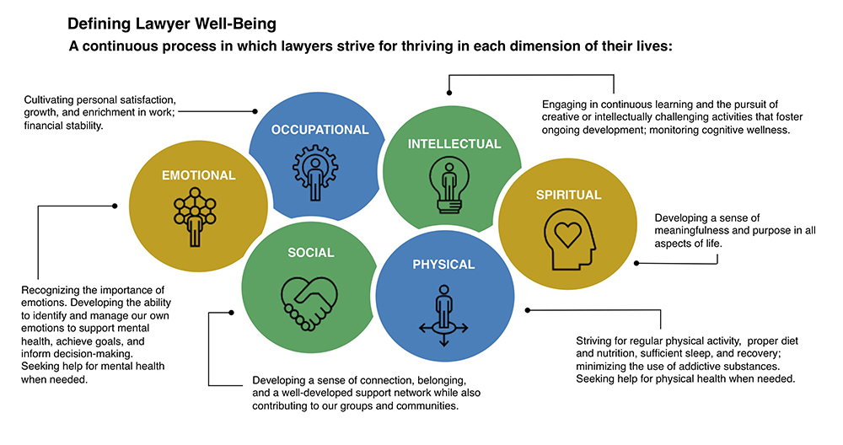

Slide 6
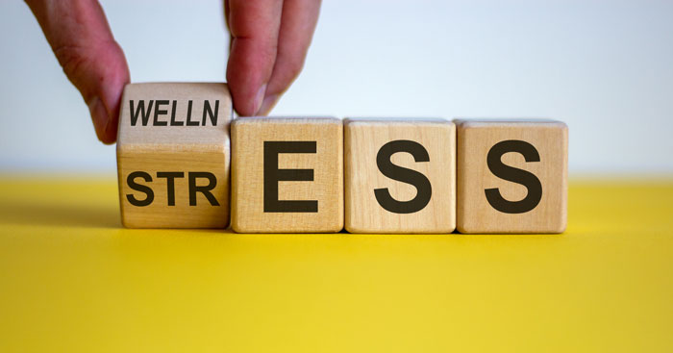
The well-being of law students is vital to the development of legal profession
Scholars pointed out a declining satisfaction among lawyers and law students (Schiltz, 1999; Daicoff, 1997)
With the globalization of legal practice, Hong Kong follows the trend of declining well-being in lawyers and law students

Slide 7
Two schools of thoughts emerged from the literature on the wellbeing of lawyers & law students:
Mental health vulnerability of lawyers and law students due to personal attributes
Lawyers and law students are pessimistic by self-selection and the nature of law: high pressure and zero-sum game (Seligman, 2001)
2. Mental health vulnerability of lawyers and law students due to contextual & environmental factors
Well-being of lawyers and law students arises from a legal profession that is plagued with commercialization and uncertainty in employment (Parker, 2014)

Slide 8
Pressure/Workload?
Pessimism?
Perfectionism?
= BURNOUT
Notes:
WORKLOAD:
Relentless need to meet insanely tight deadlines
Unsustainable volumes of work
inconsistent / gruelling hours
Huge responsibility for even the most minor failure
PESSIMISM:
makes a good lawyer;
is a well documented “major risk factor for unhappiness and depression”;
and is a character trait “lawyers cannot easily turn off”.
PERFECTIONISTIC:
Paid to manage risk, doing things “about right” is unacceptable as a lawyer.
Even the slightest mistake can end a long and illustrious career when the same mistake in any other profession wouldn’t feature as a footnote.
As a result, lawyers are taught and rewarded for “attention to detail”.

Slide 9
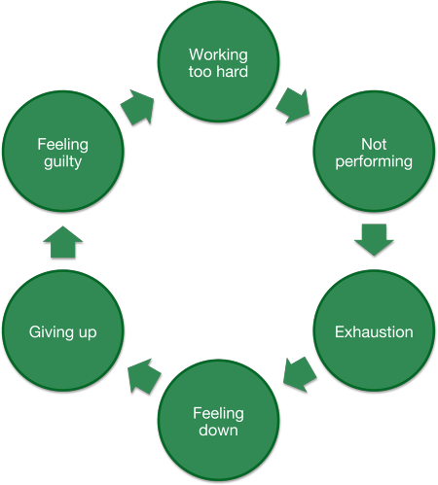
Negativity…
Cycle of depression

Slide 10
PAY ATTENTION NOT ONLY TO OUR THOUGHTS, BUT ALSO OUR EMOTIONS, BODY SENSATIONS AND IMPULSES
Thoughts
Emotions
Body Sensations
Impulses
Notes:
1. pay attention to our thoughts, emotions, body sensations and impulses

Slide 11
PAY ATTENTION TO OUR
NEGATIVE THOUGHTS
“I’ve got too much to do…”
“I’m a failure”
Name the patterns!
Recognize and record them!
Notes:
3. pay attention to our top ten negative thoughts

Slide 12
Checklist of Negative Thoughts
I feel like I am up against the world
I am no good
Why can’t I every succeed?
No one understands me
I have let people down
I don’t think I can go on
I wish I were a better person
I am so weak
My life’s not going the way I want it to
I’m so disappointed in myself
Nothing feels good anymore
I can’t stand this anymore
I can’t get started
What’s wrong with me?
I wish I were somewhere else
I can’t get things together
I hate myself
I am worthless
I wish I could just disappear
What’s the matter with me?
I am a loser
My life is a mess
I am a failure
I’ll never make it
I feel so helpless
Something has to change
There must be something wrong with me
My future is bleak
It is just not worth it
I can’t finish anything
Notes:
negative pattern of thinking

Slide 13
The more we recognize the negative thoughts as patterns, the less likely they are to ‘press our buttons

Slide 14
How do I spend my time?
What nourishes me?
Love ourselves and have more self compassion
Make choices that support my well-being and that of those around me
What depletes me?
Notes:
4. love ourselves and have more self compassion
Living with Care and Responsiveness
Consider the questions….

Slide 15
TAKE CARE OF YOUR PHYSICAL & MENTAL WELLBEING
Develop self-care habits
for your daily routine
Simplest way: Daily physical exercise!

